Slide 1
Analyzing Supermarket Sales Trends: Leveraging AWS EMR, Spark, and QuickSight for Insightful Visualizations
CPSC - 531 ADVANCED DATABASE MANAGEMENT SYSTEMS
PROF: TSENG-CHING JAMES SHEN,PhD
Team members:
Ajaykumar Burigari
Dinesh Daki

Slide 2
CONTENTS
Problem Statement
Dataset Overview
Architecture
Implementation Approach
Analysis & Results
Tools and Technologies

Slide 3
Project Statement:
This project aims to predict weekly sales for supermarkets while analyzing the factors influencing sales. This analysis will inform strategies for optimizing inventory management and resource allocation.

Slide 4
Dataset Overview:
The dataset provided comprises historical sales data for 45 Walmart stores situated across various regions.
The dataset includes the following files:
stores.csv: This file contains anonymized information about the 45 stores, specifying their type and size.
train.csv: Historical training data covering the period from 2010-02-05 to 2012-11-01. Fields in this file include:
Store: Store number
Dept: Department number
Date: Week
Weekly_Sales: Sales for the given department in the specified store
IsHoliday: Indicates whether the week is a special holiday week

Slide 5
Dataset Overview:
test.csv: Similar to train.csv, but with sales data withheld.
features.csv: Contains additional data related to the store, department, and regional activity for the given
dates.
Fields include:
Store: Store number
Date: Week
Temperature: Average temperature in the region
Fuel_Price: Cost of fuel in the region
CPI: Consumer Price Index
Unemployment: Unemployment rate
IsHoliday: Indicates whether the week is a special holiday week

Slide 6
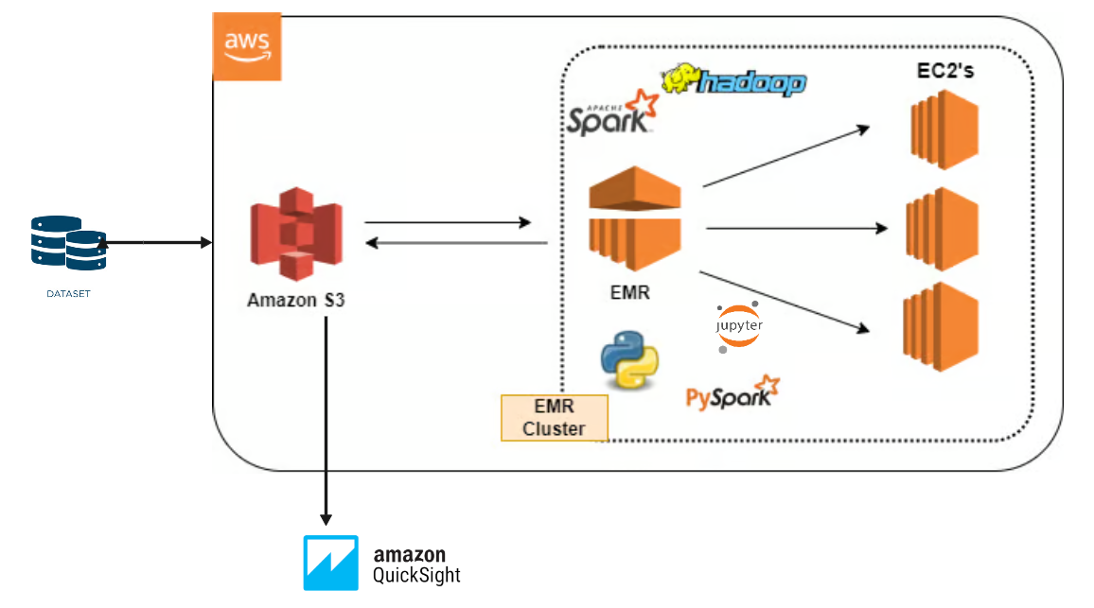
Architecture:

Slide 7
Implementation Approach:
Creating an EMR cluster
Creating S3 bucket
Creating EMR studio within EMR cluster
Fetching data from S3 Bucket
Creating Quicksight and connecting it to S3 bucket.

Slide 8
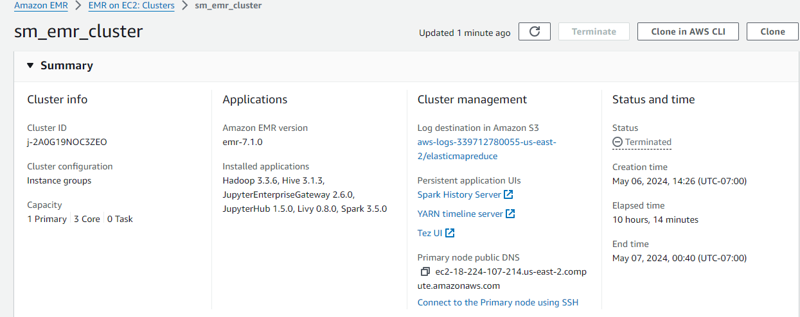
Creating EMR Cluster:
created an EMR cluster with cluster size of min 3 instances and max 10 instances and 8 core nodes.
Installed applications like Spark, Hadoop, JupyterEnterpriseGateway which helps in processing and analyzing large datasets.

Slide 9
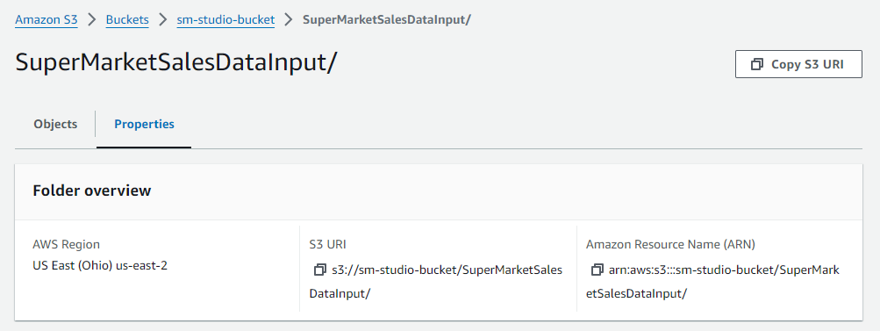
Creating S3 Bucket:
Create an S3 bucket, This S3 bucket acts as a Storage location for EMR studio.
Upload the Dataset into the S3 Bucket
Use S3 URI to read dataset files in EMR Studio

Slide 10
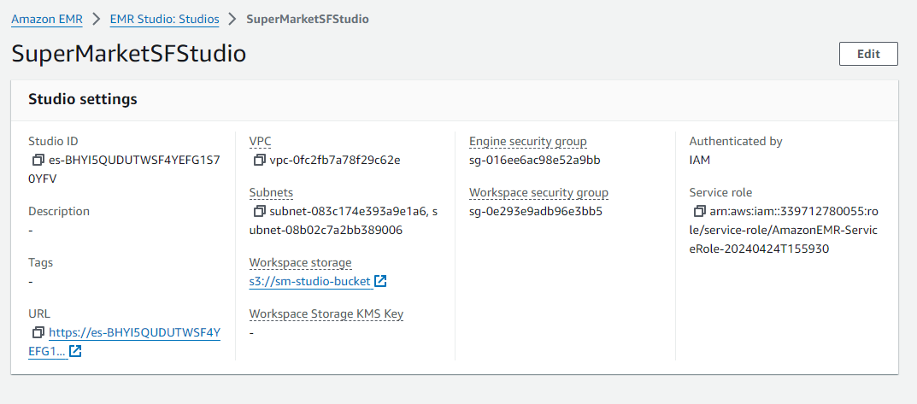
Creating EMR Studio within EMR Cluster:
Create EMR Studio
Connect EMR Studio to S3 Bucket for dataset Storage access

Slide 11
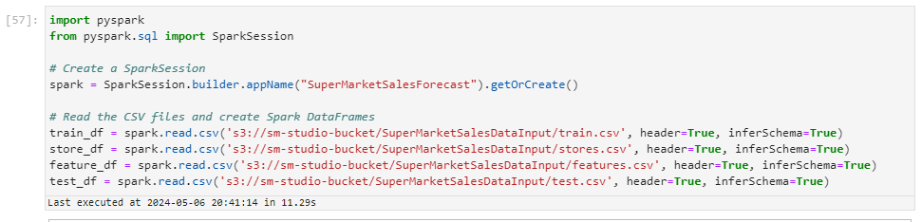
Create Spark Session with name SuperMarketSalesForecast
Creating spark dataframes from csv files containing train, store, feature and test data

Slide 12
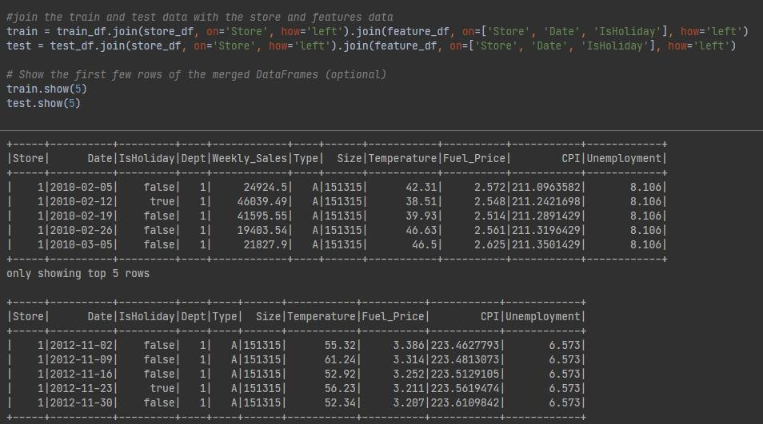
Joining train and test data dataframes with the store and feature dataframes based on columns ‘store’, ‘date’, ‘isHoliday’ to create train and test data.

Slide 13
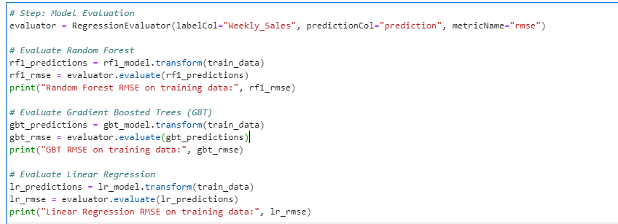
Created 3 regression models RandomForest, Gradient Booster Trees, Linear Regression.
Predictions are made on the training data with each model and RMSE is computed.
Each model is trained on the training data and predictions are made.
Based on the RMSE values obtained, the code selects the model with lowest RMSE as the best model.

Slide 14
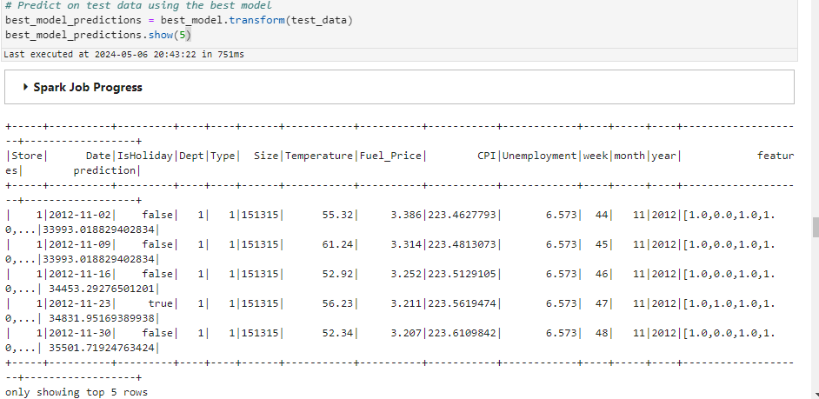
Predictions are made on the test data using best model.

Slide 15
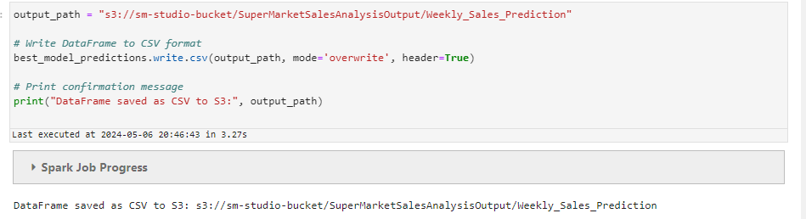
Saving the predictions made by the best regression model into a folder located at the specified amazon S3 bucket path.

Slide 16
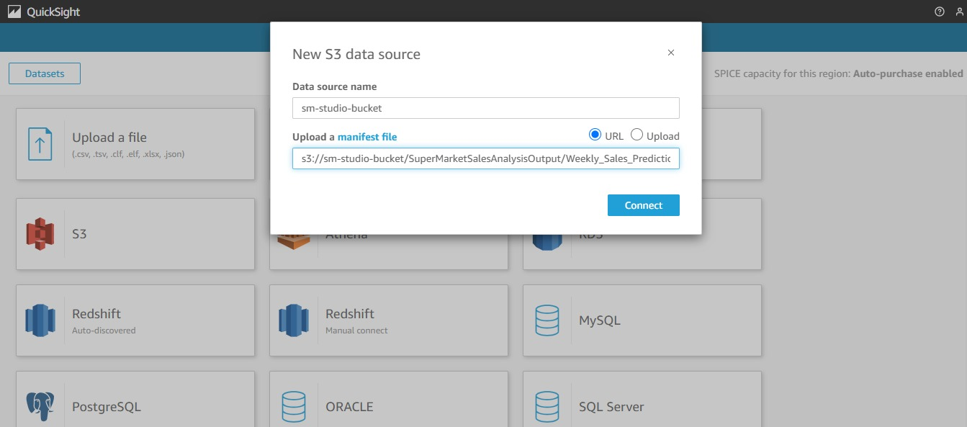
Connecting S3 Bucket to Quicksight:

Slide 17
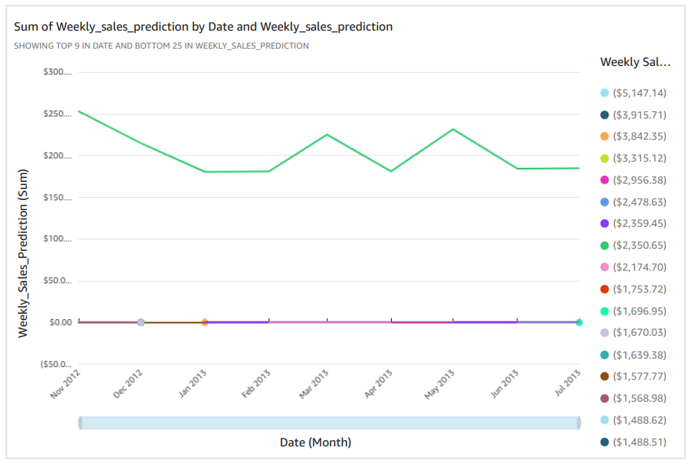
Results:
Sales Predicted

Slide 18
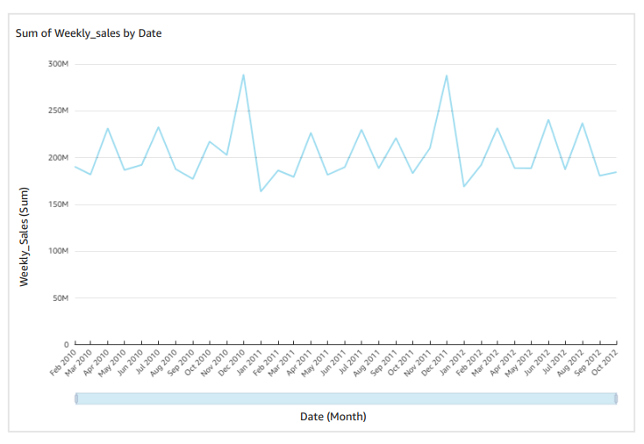
Results:
Sales Obtained from the trained data

Slide 19
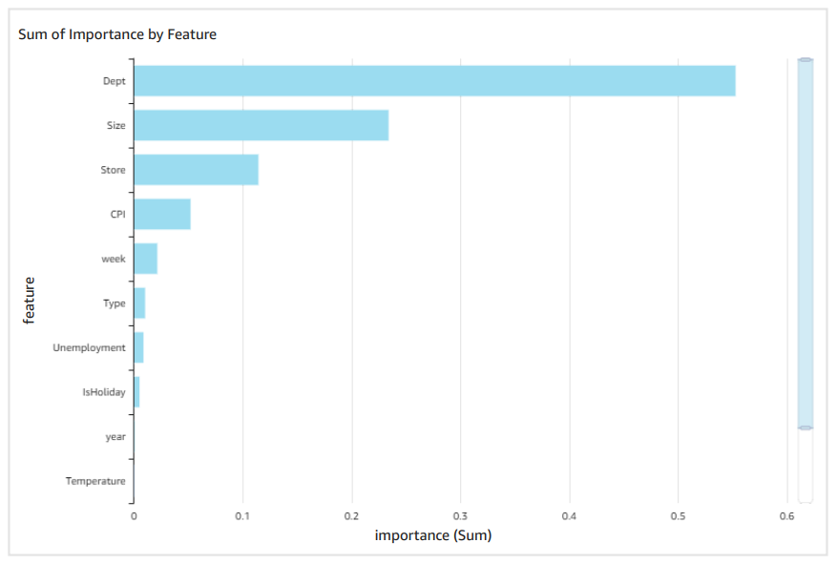
Results:
Feature importance

Slide 20
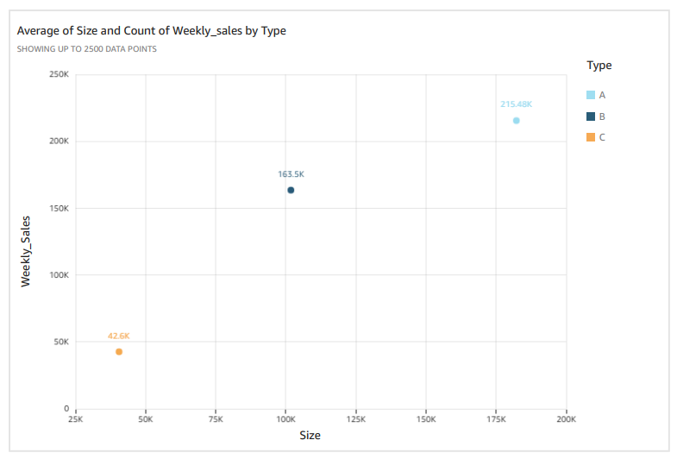
Analysis:
As the size of the store increases, so do its weekly sales.

Slide 21
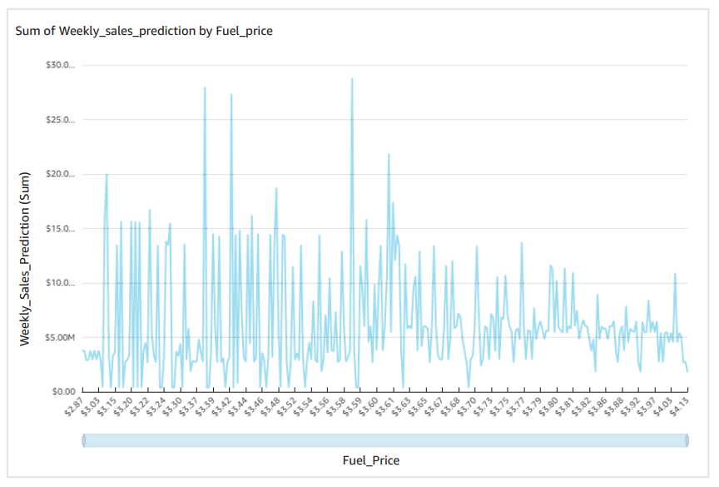
Analysis:
Fuel prices and weekly sales share a correlation, with sales demonstrating a decline during periods of higher fuel costs.

Slide 22
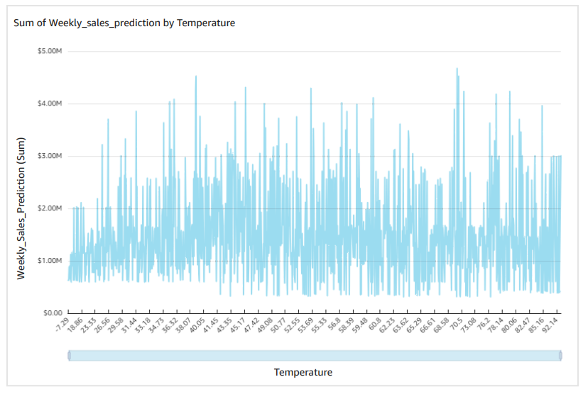
Analysis:
Temperature and weekly sales exhibit a correlation, with sales showing lower figures during both the highest and lowest temperatures, while demonstrating higher sales during moderate temperatures.

Slide 23
Tools and Technologies used:
• AWS Ecosystem:
AWS EMR
Amazon S3
EMR Studio
AWS QuickSight
• Big Data Technologies:
Apache Spark and PySpark
• Notebook:
Jupyter Notebook

Slide 24
THANK YOU

